Slide 1

Booking and management system
BINAG, Deborah p.
Lino, Alyssa jane b.
Parian, Danica faith m.
it111

Slide 2
Background of the client
AMPAPhil Inc. is a Non–Construction Philippine-based human resource recruitment and deployment agency, which takes pride in providing world-class Filipino professional and skilled workers and performing artist.
A member of Overseas Placement Association of the Philippines (OPAP) and also a member of Philippines Association Services Exporters INC. (PASEI)

Slide 3
Background of the client
Specializes in:
Mobilization, sourcing and pooling of applicants based on clients’ specifications;
Preliminary screening and testing prior to final selection by the principal and/or employer;
Document processing in POEA and at the Embassy of the country of destination, when necessary; and
Orientation, briefing meetings and Pre-Departure Orientation Seminar
Talents offered: Singing and Dancing with specific specialization each

Slide 4
Problem statement
Artist Managers Placement Agency of the Philippines or AMPAPHIL, in short, is still using a pen and paper in its day-to-day operation. With this kind of system, a lot of risks exist such as loss of records, slow processing, costly due to supplies, and a large space in the office is consumed due to the storage of all the printed documents.
Also, most of the talent agencies here in the Philippines use automated systems already where all the key players such as applicants, clients and even events relating to the agency is monitored and stored in a system. AMPAPHIL wants to cope up with this technology to maintain competition with a lot of talent agencies today.

Slide 5
Background of the project
Project Objectives
To keep track of the records of each talent the agency handles
To be up to date with the technology
To enable future talents and clients to communicate with the agency in a convenient way
To reduce the time in their daily operation
To inject paperless registration of talents and events to minimize time and space for records in the workplace
To provide a management solution resulting to good relationships between artists and clients

Slide 6
Target User Beneficiaries
The target users of this system are the following: 1. Administrator or employees of the agency 2. Existing and future clients of the agency 3. Existing and future applicants of the agency

Slide 7
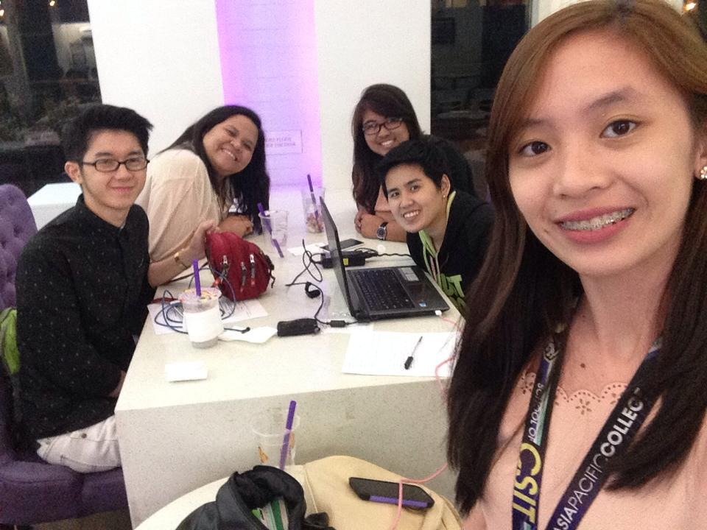
Iteration 1 pictures and evidences
With our Clients Mr. Leo Laforteza and Ms. Stephanie Factuar
March 12,2015 at Emerald, Ortigas

Slide 8
Iteration 1 pictures and evidences
Client Feedback Form
Meeting Minutes 1
Meeting Minutes 2
Meeting Attendance

Slide 9
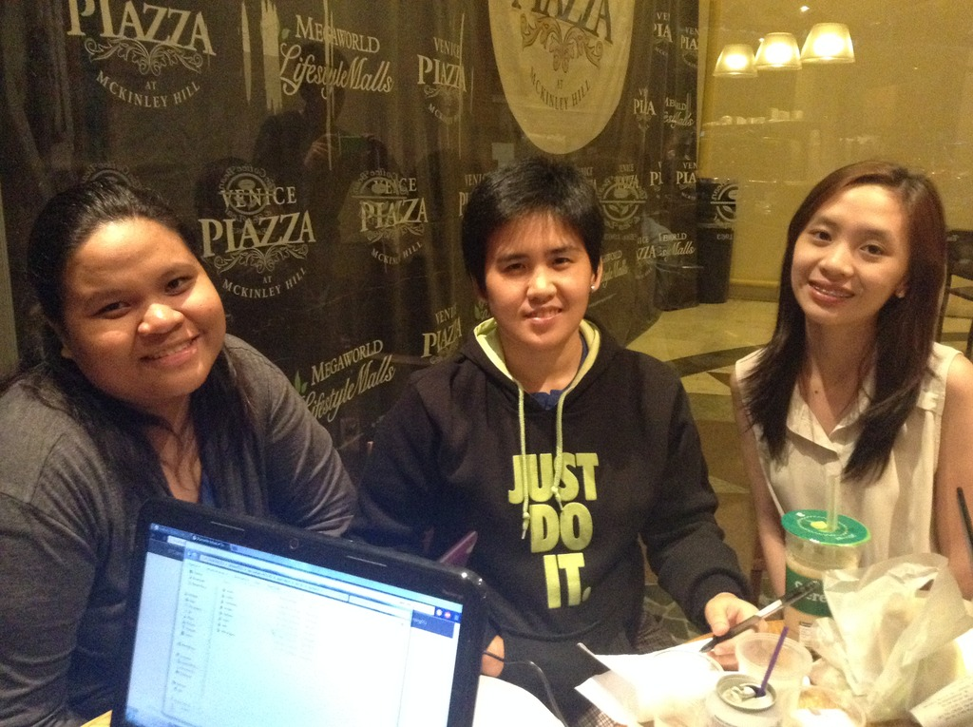
Iteration 2 pictures and evidences
With Ms. Stephanie Factuar
April 1, 2015 at Mckinley Hill, Taguig City

Slide 10
Iteration 2 pictures and evidences
Client Feedback Form
Meeting Minutes
Meeting Attendance

Slide 11
Individual contribution
Deborah Binag
Database Design
Model and CRUD of applicant, employee & events
Dropdown list in each module
Confirm events in the Events table
Embedded Google map
Documentation

Slide 12
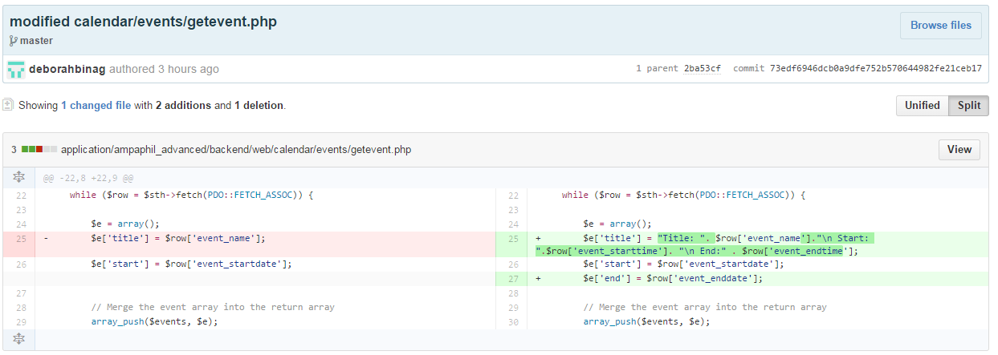
Individual contribution
Latest Commit w/ Diff

Slide 13
Individual contribution
Danica Parian
Database Design
Model and CRUD of manager, client & payments
Display view for each module
Half of Applicant module regarding Applicant status
Help page
Documentation

Slide 14
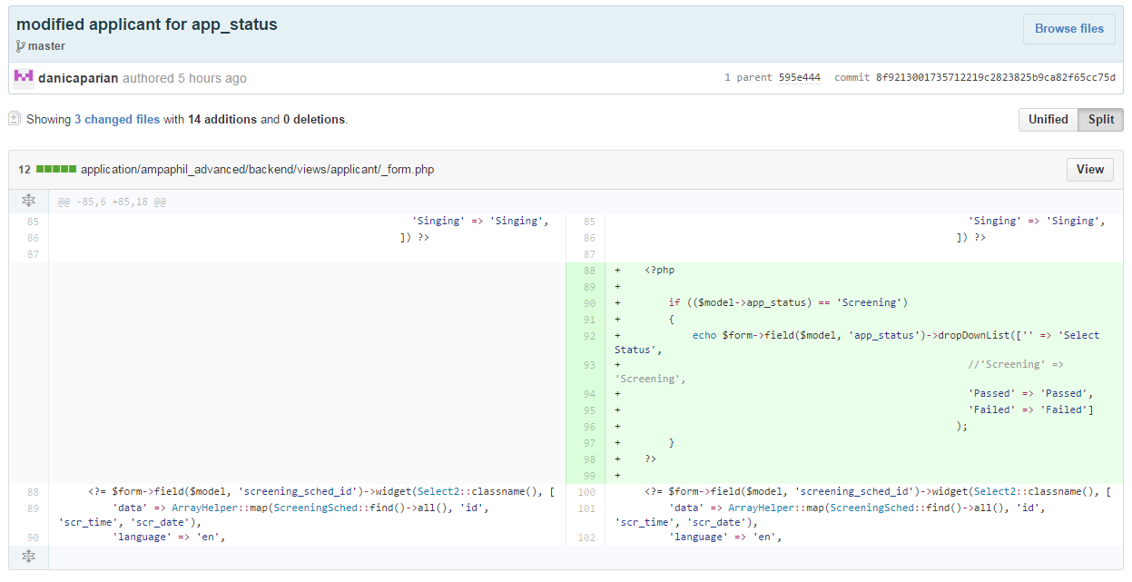
Individual contribution
Latest Commit w/ Diff

Slide 15
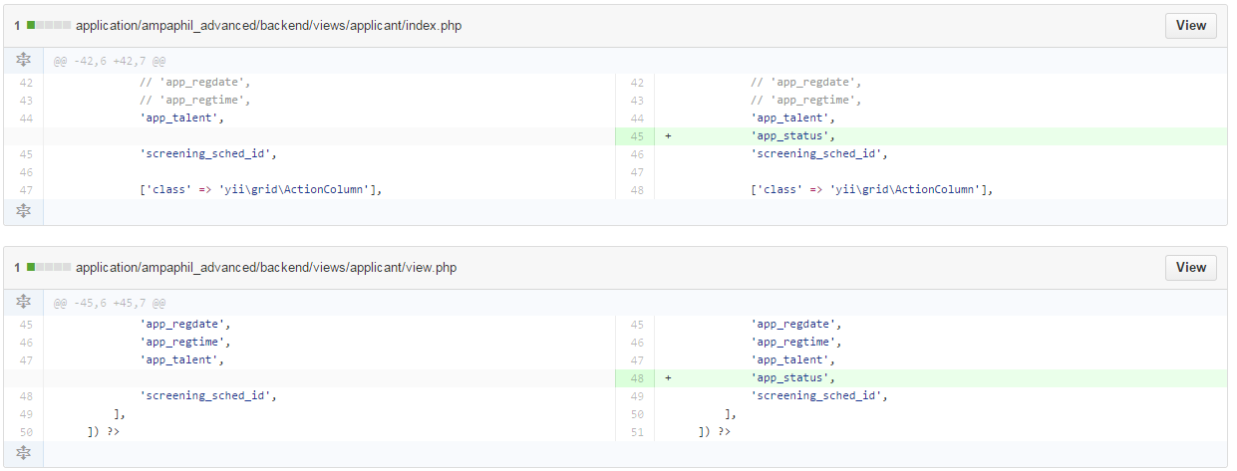
Individual contribution
Latest Commit w/ Diff

Slide 16
Individual contribution
Alyssa Jane Lino
Database Design
Model and CRUD of talent, event_details, talent_line & screening_sched
Design/User Interface
Search Functions
Auto update of Applicant status
External Functions
Applicant to talent
Calendar

Slide 17
Individual contribution
Latest Commit w/ Diff
Screenshot 1
Screenshot 2
Screenshot 3
Screenshot 4
Screenshot 5

Slide 18
DEMO

Slide 19
Current status of the project
95% Completed
Remaining to be completed:
Manager and Transaction Module(but this is for Future Maintenance)
Client Feedback about Interest
To be determined in Iteration 3 – Final Presentation to the client

Slide 20
Next steps
Final Presentation Schedule with the Client
- April 15, 2015
Plans for Continuing the Project
- To be determined in Iteration 3 – Final Presentation to the client

Slide 21
THANK YOU!!

